Slide 1

CEIR Importer Training Manual

Slide 2

Agenda
Importer Definition and Overview
Assumptions
Features
Registration
Dashboard
Type Approval Request
Consignment
Stock Management
Grievance
Profile Management

Slide 3
Importer - Definition
An entity who interact with suppliers of Mobile devices or any SIM based devices and have business agreement with such suppliers to bring the SIM based devices in Cambodia for Cambodia based users to use.
Importer is responsible for paying the Import duty to Cambodian customs.
Importer can be Distributor or Retailer as well or both.

Slide 4
Overview

Slide 5
Importer – Roles
Pls note Buying and selling of devices are done outside the scope of CEIR system.

Slide 6
Assumption

Slide 7
Registration – Importer

Slide 8
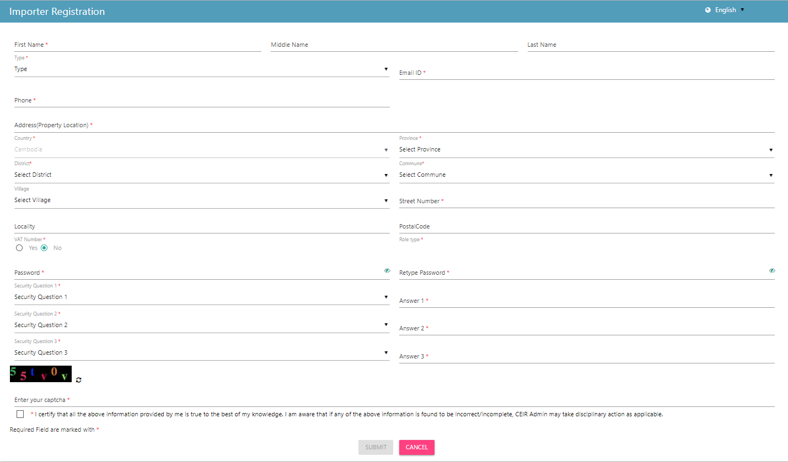
Registration – Importer (Form)

Slide 9
Dashboard – Importer

Slide 10
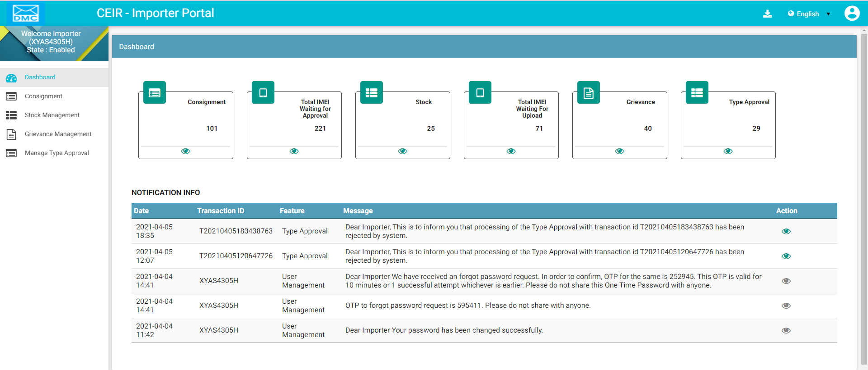
Dashboard – Importer
Download User Manual
Left Panel
Work Area
All features status
Edit Profile
Language Change
On click it takes user to respective home page
Notifications

Slide 11
Type Approved – Importer

Slide 12
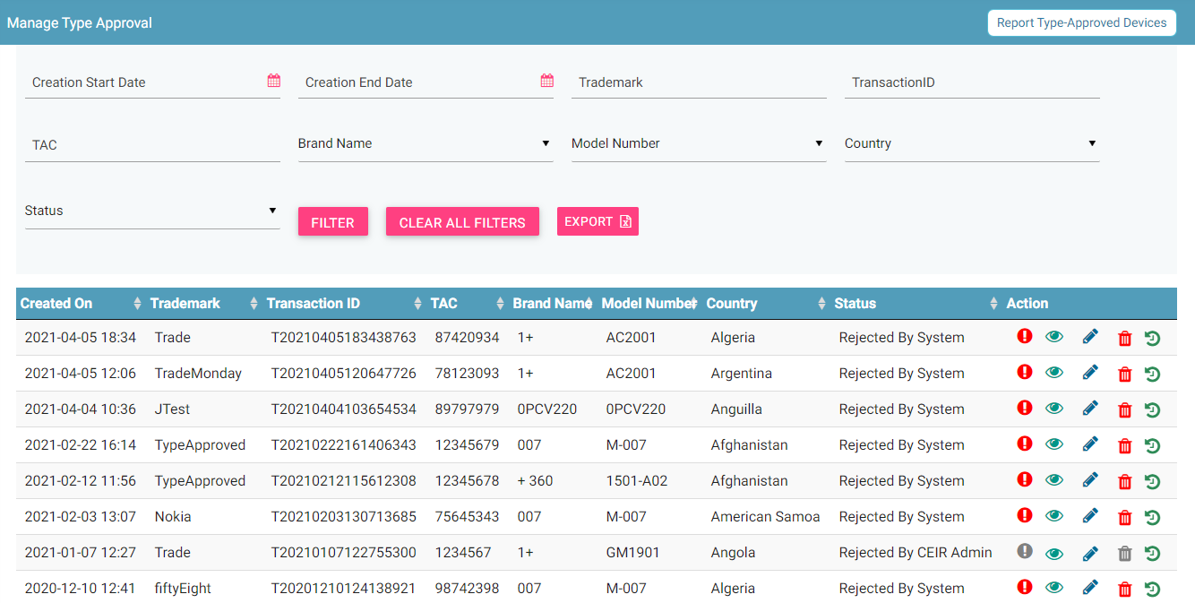
Type Approval – Importer
Filters
Request Type Approval
Export
Action like View, Edit & Delete
View All requests

Slide 13
Consignment – Importer

Slide 14
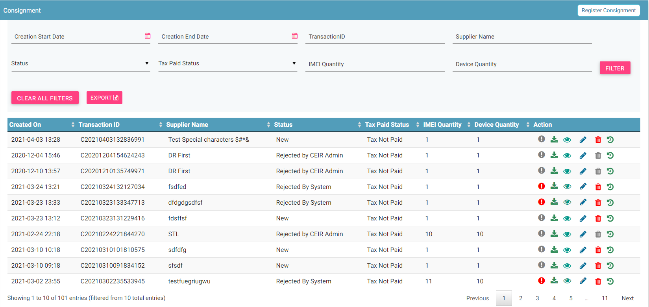
Consignment – Importer
Register
Filters
Export
Action like View, Delete
View All Consignment
© 2019-2020 Sterlite Technologies Limited
14

Slide 15
Stock Management – Importer

Slide 16
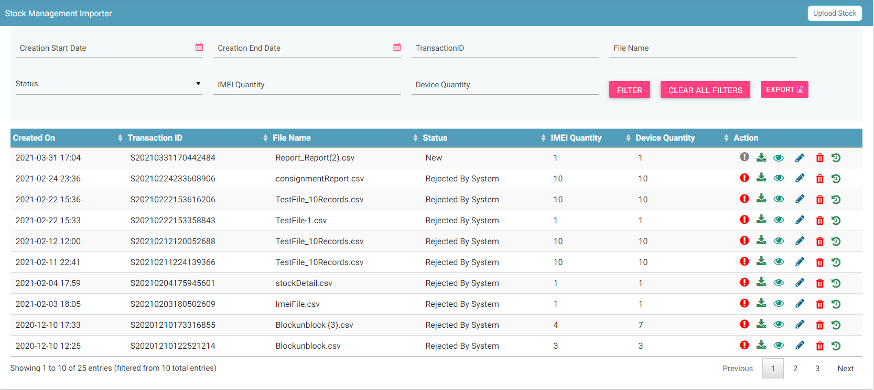
Stock Management – Importer
Export
Filters
Upload
Action like View, Delete
View All Stocks

Slide 17
Grievance – Importer

Slide 18
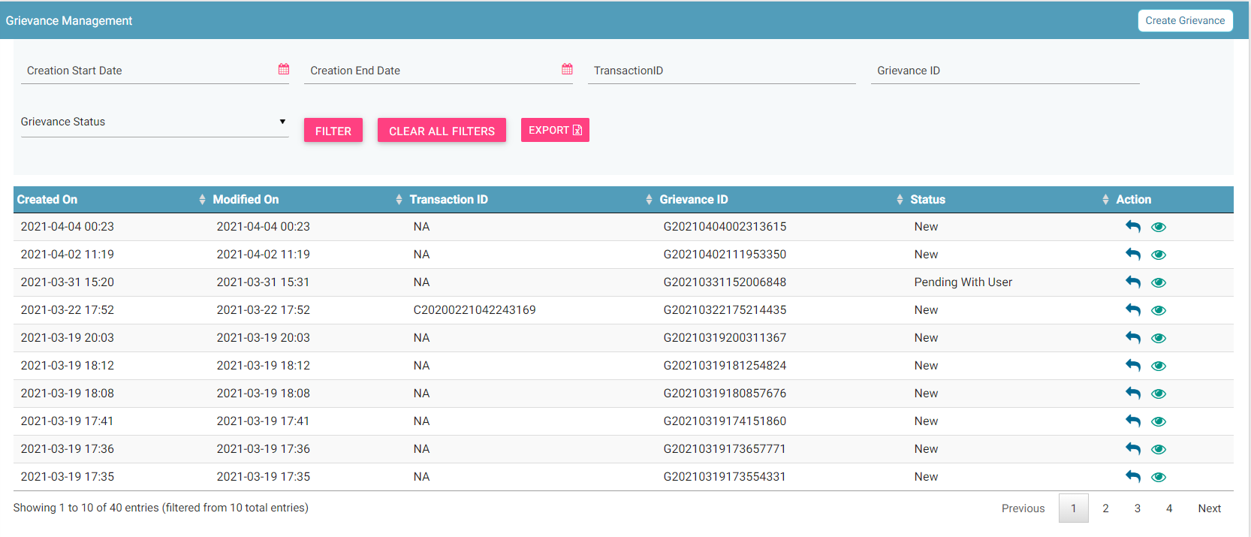
Grievance – Importer
Report
Filters
Export
Action like View, Reply
View All grievances

Slide 19
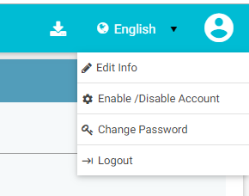
Profile Management – Importer

Slide 20
Queries

Slide 21
Thank You

